Slide 1



Train the Trainer
Safe Handling of Medication In Home Care
Home Care Association
& Be Caring

Slide 2











Just a bit of housekeeping first
Fire Alarm
Toilets
Comfort breaks
Comfort breaks
Timekeeping
Fire alarm
Phones and Emails

Slide 3
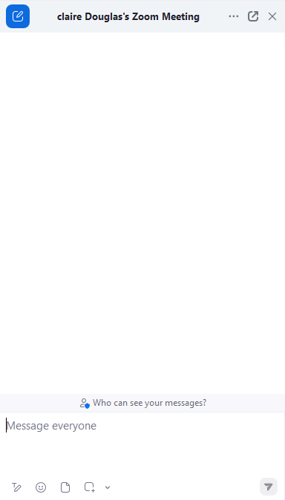


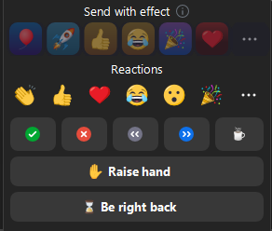



Slide 4

Learning Outcomes
To receive information and guidance in how to train your Care Workers to deliver medication services safely.
To gain knowledge on all aspects of providing medication services.
To discuss common errors. When things do go wrong and how to prevent and support.
To understand how competency can be tested.

Slide 5


Break out
Small groups
5 Things in 5 Minutes

Slide 6


Why do we need to train care workers in medication?
What might happen if we don’t train them efficiently?
Ensure safe Administration
Medication Errors
Recognise Side Effects and Adverse Reactions
Understand Legal and Ethical Responsibilities
Legal consequences
Delayed Emergency Responses
Promote independence
Increased Health Costs
Maintain Accurate Records
Loss of Trust

Slide 7


How do we, as trainers, ensure the learners want to learn?
Break out Equal Groups
Make the training interesting
Interactive Activities
Involve learners
Use your own scenarios
Understand how people learn
Adapt teaching methods
Provide constructive Feedback

Slide 8



What Type of learner are you?
Activity 1
Independent
Activity 1
If the majority of your responses were (a), you are a visual learner.
If the majority of your responses were (b), you are an auditory learner.
If the majority of your responses were (c), you are a kinaesthetic learner.
Auditory Learning
Kinaesthetic Learning

Slide 9







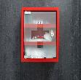
Key Legislation
GDPR
Activity 2
Break out Equal Groups
Medicines Act
1968
Protects how personal information is stored and shared.
Health and Safety at Work Act 1974
Ensures medicines are safe and correctly made, labelled, prescribed, and used.
Employers to provide training, safe equipment, risk assessments and PPE.
Misuse of Drugs Act 1971
It aims to prevent the misuse of controlled drugs.
The Mental Capacity Act 2005
Ensures people are supported to make their own decisions and protects those who can’t.
The Human Medicines Regulation 2012
The Control of Substances Hazardous to Health (COSHH) 2002
Brings medicine policies together and regulates how human medicines are made, licensed, prescribed and supplied.
Safe use, storage, and disposal of hazardous substances and requires staff to report risks.
.

Slide 10
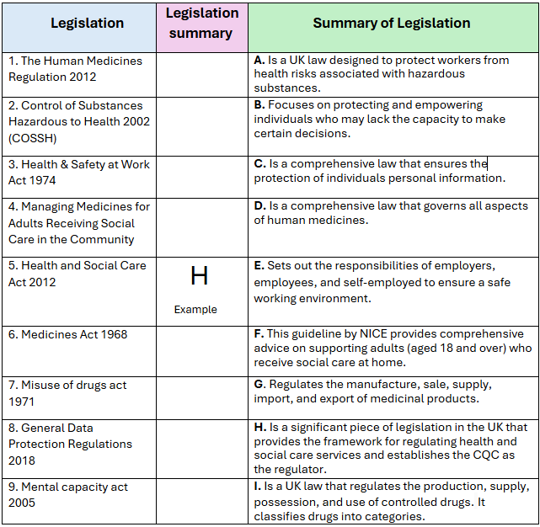
Activity 2
D
Activity 2 Answers
Groups
A
E
F
Legislations Activity
G
I
C
B

Slide 11


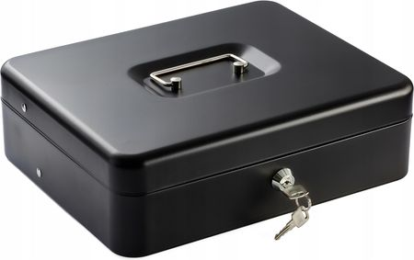



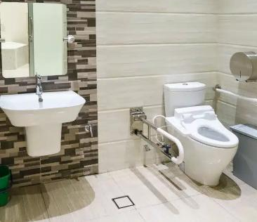
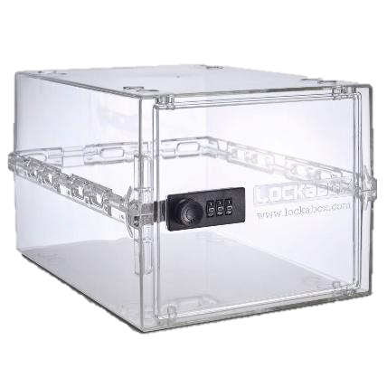
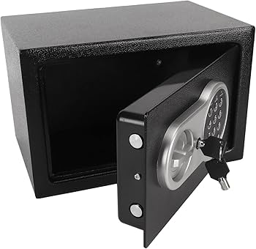

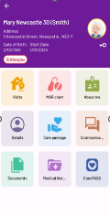


Storage of medicine

Slide 12

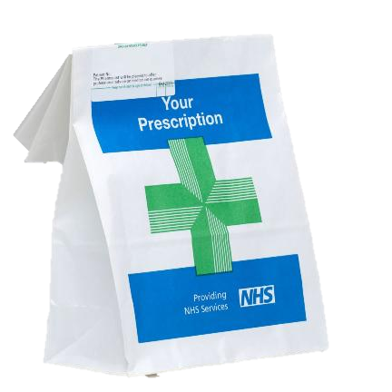
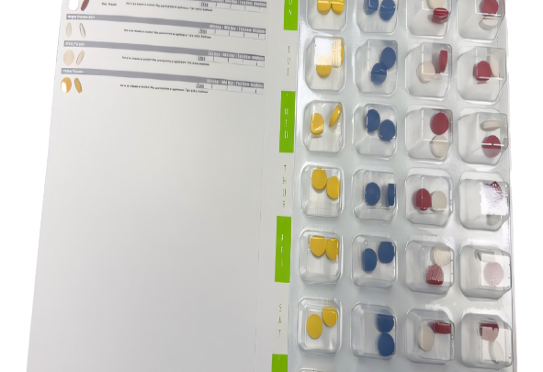
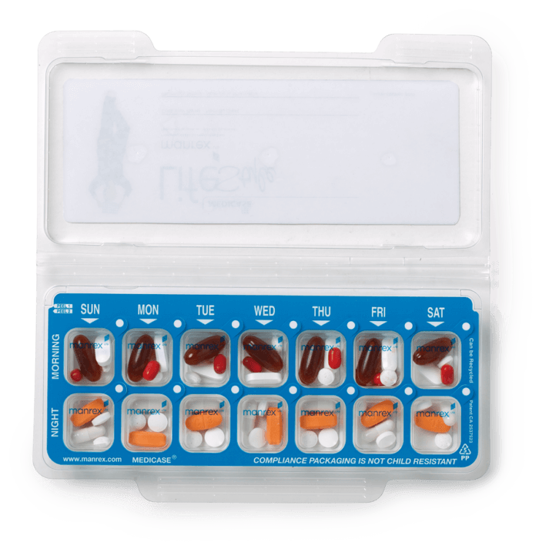
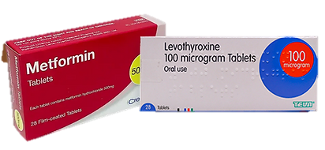
Monitored Dosage System - MDS
Separate Packs

Slide 13
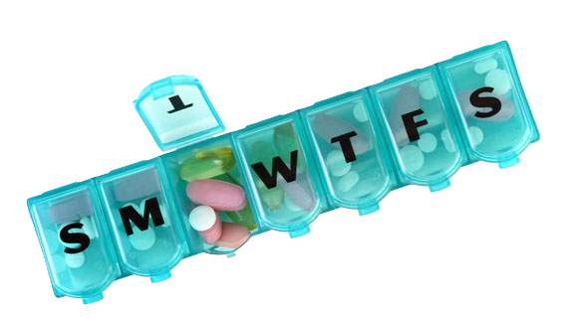
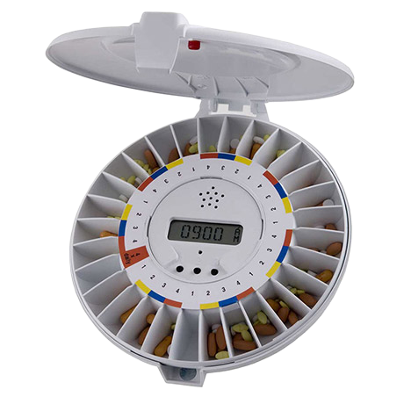
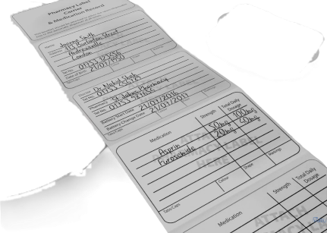
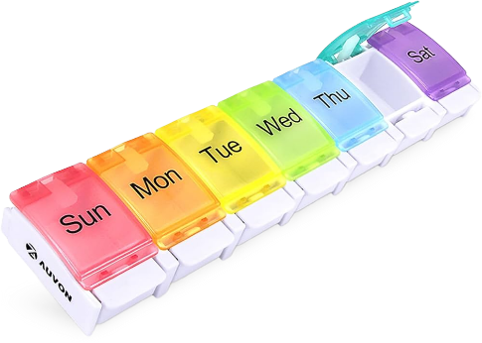
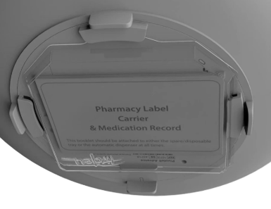
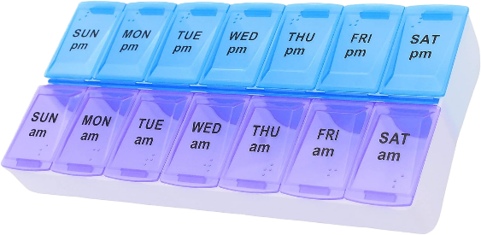

Slide 14

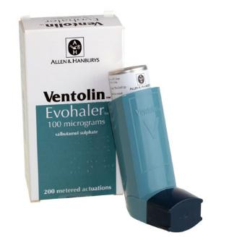
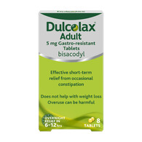

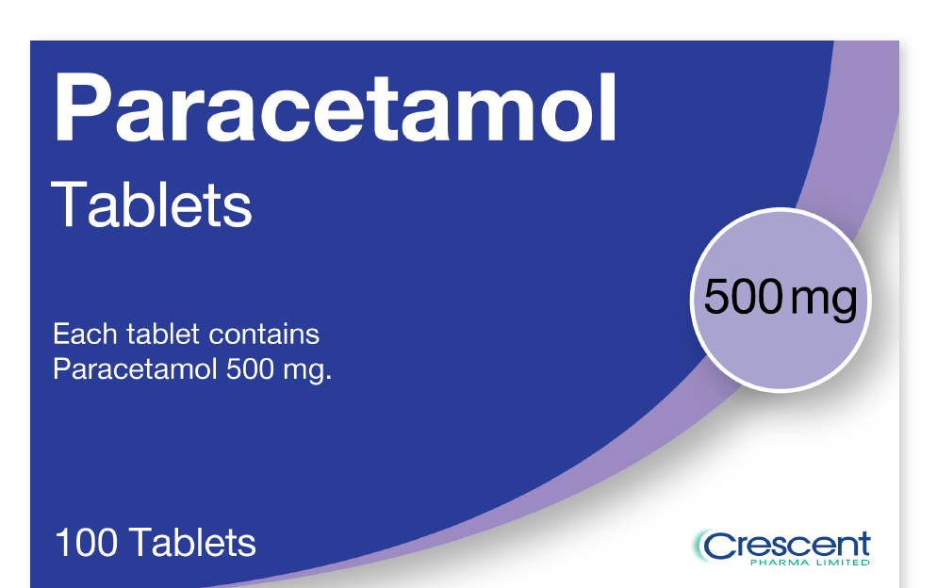
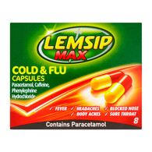
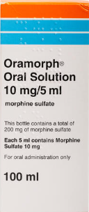
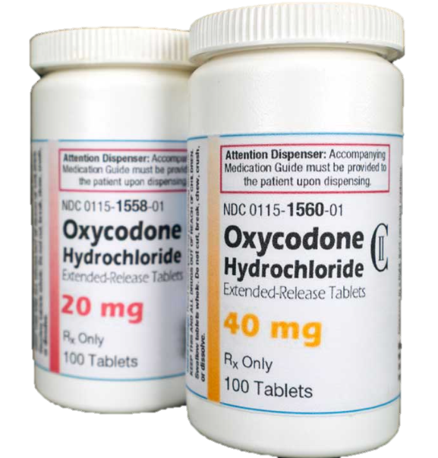
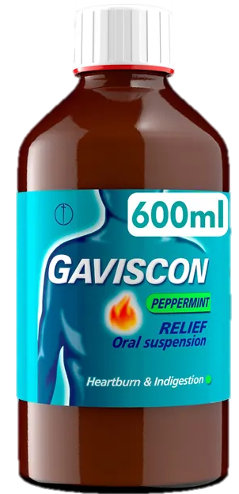
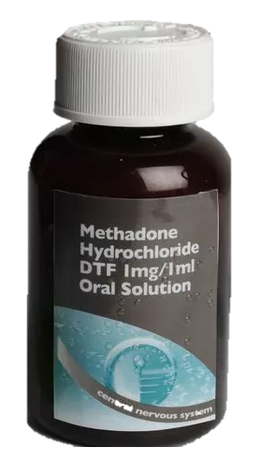

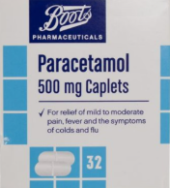

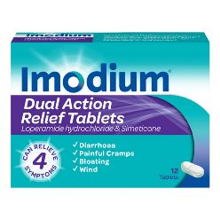

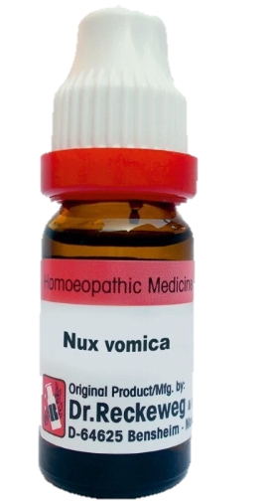

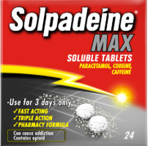
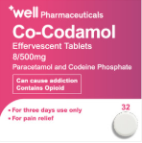
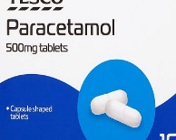
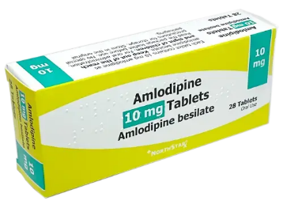
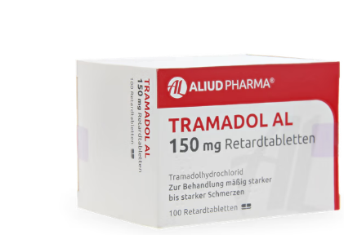
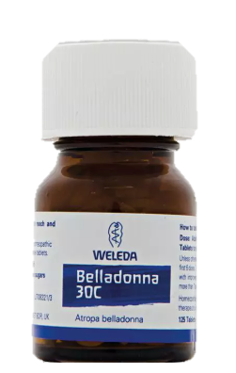
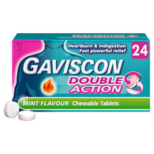

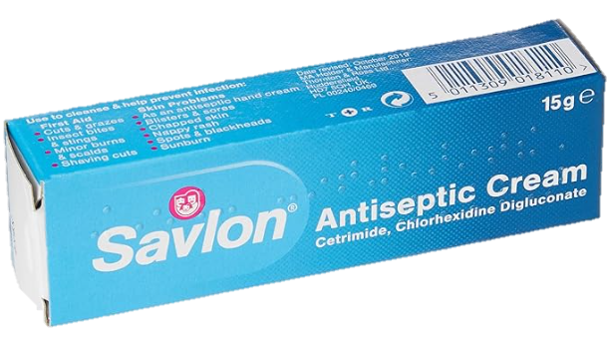
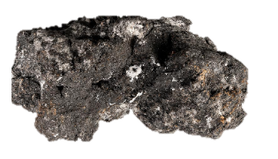
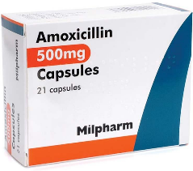
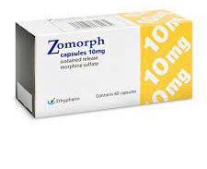
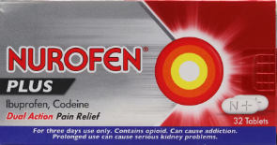



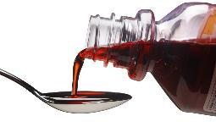

Medication Classification
Over the counter
Prescription only medication
Pharmacy medicines
General Sales List
Controlled drugs
Complementary/homeopathic remedies
They are more tightly controlled than GSL but do not require a prescription. Pharmacist will ask for your medical history to determinate where is safe and appropriate for you to take it.
Medicines can be purchased over the counter in many shops, supermarkets or online. They are considered safe for use without professional supervision, provided users follow instructions on packaging.
POM, requires a valid prescription form qualified medical professional.
They are classified under POM but due to their addictive nature they are restricted by more strength control measures.
- “Good Manufacturing Practices”. A manufacturing plant is GMP certified after passing strict inspections by the Health Ministry Labelled on the box without exception.
Are nonprescription medicines available in pharmacies and general shops Used for minor health problems.
GSL
GSL
GSL
GSL
GSL
GSL
P
P
P
OTC
P
OTC
OTC
P
OTC
P
OTC
OTC
POM
POM
POM
CD
POM
CD
CD
POM
CD
POM
CD
CD
HR
HR
HR
HR
HR
HR

Slide 15


The Role of the Prescriber
(GP, Consultant, Nurse Prescribers, dentists)
Responsible for prescribing medications.
Must complete an initial assessment to ensure correct medication is prescribed
Ensure there are no contraindications
Explain why the medication is required, what effects it will have, any instructions that need to be followed and any side effects that may be experienced
Ensure their prescriptions comply with the legal requirements of the Human Medicines regulations 2012 and the Misuse of Drugs Act (1971)
This then goes to pharmacist…..

Slide 16


The Role of the Pharmacist
The pharmacist will check that the prescription is valid, accurately dispense the
medication and legally label the container with:
Nine informative points for labels
• The name of the individual
• Date of supply
• Name and address of the supplier
• Name of the medication
• Dosage of the medication
• Route of administration
• Directions for use/frequency
• Special instructions, warnings or cautions
• Expiry date

Slide 17

The role of the Transcriber
Transcribing can be defined as the act of making an exact copy, usually in writing or digitally.
Transcribing is the copying of previously prescribed medicines details to enable their administration.
Transcribing can only be used to make an exact copy of medicines that have already been prescribed.
Who is the transcriber in your company?

Slide 18

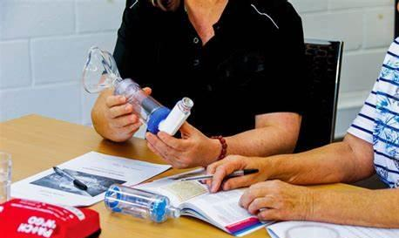
Training Transcribers
• Those undertaking transcribing must be appropriately trained and assessed as competent.
• There should be an audit trail for all transcribed medicines.
• Medicines must not be transcribed where details are illegible, unclear, ambiguous or incomplete.
• Particular care is taken in transcribing details of high-risk medicines such as anticoagulants, change of dose/reverting back to original, cytotoxins, or controlled drugs.
• Your policy should clearly state your procedure for dealing with errors in transcribed information. Likewise reference learning outcomes that can be evidenced.

Slide 19

The role of the Care Worker
Care workers are the final safety check.
Care workers must check all prescribed medications against records to ensure the right person gets the correct medication, dose, and timing.
Safe administration means informing clients, respecting their choices, and following legal guidelines.
Must respond promptly to side effects or adverse reactions.
Care workers must understand recording and reporting procedures to manage unexpected events, ensure safety, and maintain continuity of care.

Slide 20

Activity 3
Break out
3 Equal Groups
A Persons own medicines that have been
prescribed by a GP and then dispensed by a pharmacy
can then be transcribed onto a
Medicines Administration Record (MAR)
by the transcriber.
Their administration of medication can then be carried out and recorded by the
social care staff member
or an allocated trained competent other.
The Final Safety Check

Slide 21
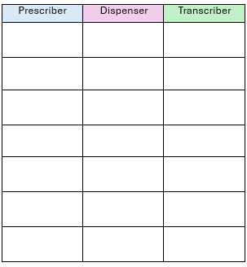
Prescriber
Pharmacist
Transcriber
Assess the patient's condition.
Accurately interpret prescriptions
Accurately read and interpret prescriptions or medication labels
Select appropriate medications
Prepare and label medications
Transcribe medication details onto the MAR exactly as written
Explain the purpose, dosage, and potential side effects.
Check for potential dispensing errors
Double-check transcriptions
Check for potential drug interactions
Provide clear instructions
Clarify any unclear instructions
Ensure prescriptions are legally compliant
Offer advice on possible side effects
Ensure the MAR is legible, complete, and up to date
Monitor the patient’s response
Collaborate with prescribers and other healthcare professionals
Report and document any discrepancies
Verify patient identity before handing over medication.
Work collaboratively with care staff and healthcare professionals
Educate the patient

Slide 22
Levels of Medication support
Traditionally, organisations have described the level of service required as
Prompt
Assist
Administer
1st Tier
2nd Tier
3rd Tier
In England, the previous regulator, the Commission for Social Care Inspection (CSCI) outlined what was meant by the three terms above.
However, from October 2010, the new regulator, the Care Quality Commission (CQC) removed this description, with an expectation that you describe the service your organisation provides to service users.

Slide 23

Prompt
Assist
Administer
1st Tier
2nd Tier
3rd Tier
Why do we need to Report a change?
  Safety and Accountability
  Care Plans Must Be Updated
  Protecting the Individual’s Rights
  Legal and Regulatory Compliance
  Clear Communication
Self Administer

Slide 24

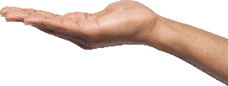


?
?
asked
FAQ
?
questions
frequently

Slide 25


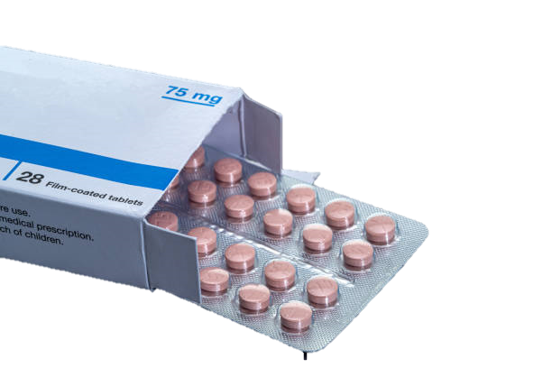
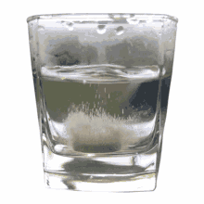
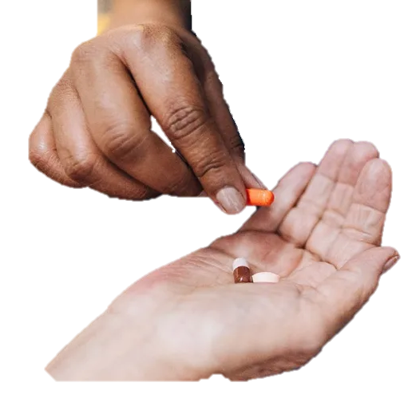
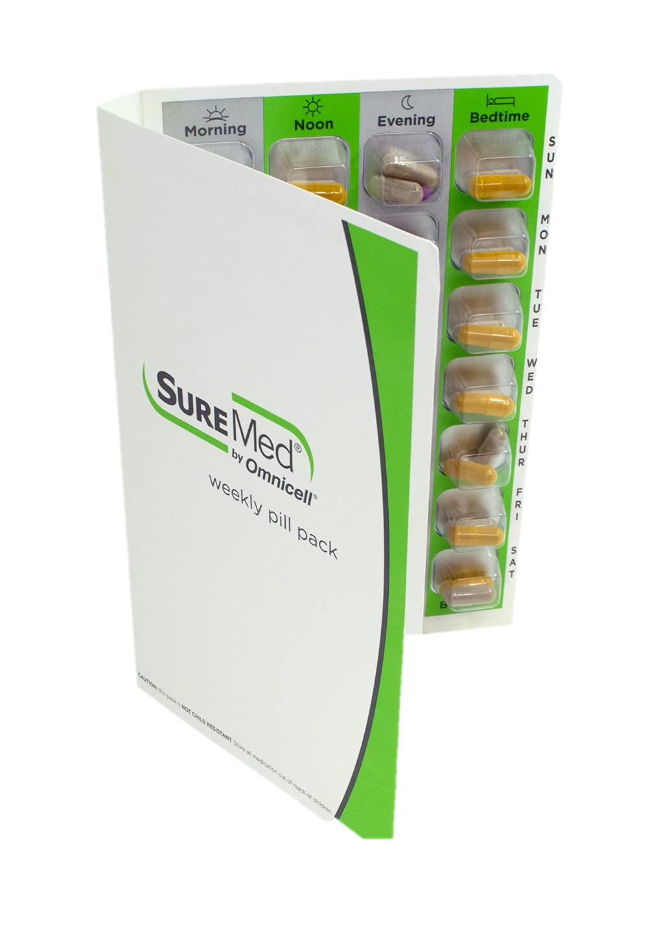











Slide 26
Q
Administration
Can care worker refuse to administer if something doesn't look right?
Yes,
If anything about a medication doesn't look right, a care worker must stop, not administer, and contact the office immediately.
A

Slide 27
Q
Changing Levels
Can Care worker temporarily increase the level of support if the client asks just for that visit?
No,
Contact the office, they can authorise an emergency change. A care worker cannot make that decision alone.
A

Slide 28

Q
Prompt
What if the client says they've taken their medication but we're not sure?
Document what the client said, note any concerns, and report to the office.
A

Slide 29
Q
Assist
What if the client asks us to do something at assist level that isn't in the care plan?
A
Don’t do it contact the office so the care plan can be updated, then it can happen safely.

Slide 30
Q
Important Questions
Can a care worker leave medication out for a client to take after they've left?
Generally no, but there is a narrow exception that requires a risk assessment, care plan documentation.
A

Slide 31

Q
Important Questions
What if a family member gives medication on a day out or overnight do we need to record it?
A
Yes, it needs to be recorded, and the arrangement needs to be agreed and documented in the care plan before it happens.

Slide 32

Q
Prompt
What if prompting a specific medicine, like 'take your blue inhaler' is it still just prompting?
No, the moment a care worker identifies a specific medicine by name, colour, or type, that has crossed from prompting into administration.
A

Slide 33
Q
Prompt
Can Care worker give the client their medication in their hand?
A
No!
This counts as administration.

Slide 34


















PRN Pro-re-nata
“PRN” medications are medications that are taken as needed. Meaning, you can take them based on the symptoms you’re currently experiencing. You generally don’t need to take them every day.
Key Points:
  PRN medications are not taken on a regular schedule
  They are used to manage intermittent symptoms
  Prescriptions usually include specific instructions, such as "Take 1 tablet every 4–6 hours PRN for pain”
Pain
Heartburn
Allergy
Indigestion
Anxiety
Skin issues
Inhalers
laxatives
Nausea
Remember: PRN medication that is not required should not be marked as refused

Slide 35





✅ PRN Protocols
These are specific types of medication protocols used when a medication is to be given only when needed, such as for pain, anxiety, or nausea.
PRN protocols include clear guidance on:
  When to administer the medication
  What symptoms to look for
  Maximum dosage and frequency
  Monitoring and documentation requirements

Slide 36

Closer Look at a Label
Activity 4
Independent
Activity 4
Name of Medication
Strength of Medication
Special Direction
Form of Medication
Name of Patient
Dose instruction
Medication Warning
Date of Dispensing

Slide 37














Special Directions - examples
Special Directions
Take it with or after food
Do not chew or crush
Break out
Equal Groups
(Handout)
Take it on empty stomach or
30 minutes before food
A "special direction" on a medication typically refers to
specific instructions provided by a healthcare professional
or included on the medication label that go beyond the standard dosage and usage guidelines.
These directions are meant to ensure the medication is used safely and effectively for a particular patient or situation.
Take each dose with
full glass of water
Break out
Pairs
Do not take indigestion remedies, iron or calcium within two hours of taking this medicines
Special Direction
Let's do some research
Special Direction
Special Direction
Do not take this medicines if vomiting
Do not stop taking this medicines without consulting your doctor
Avoid grapefruit or
grapefruit juice
Do not drink alcohol while being treated with this medicine

Slide 38






















Prior to administration of medication,
there are some key checks that you should carry out
to enable the safe administration of medicines,
commonly knows as:
“The 6Rs” or “The 6 Rights”
The 6 Rights of Safe Medicines Administration
RIGHT PERSON
RIGHT MEDICINE
RIGHT DOSE
RIGHT TIME
RIGHT ROUTE
RIGHT to REFUSE
Right Dose
Right Time
Right to Refuse
Right Medicine
Right Route
Right Person
Always check dose on the pharmacy label and MAR/eMAR
Remember to check if you are administering out of right slot
Remember that your client has got right to refuse medication
Remember to check medicines against MAR/eMAR chart
Check that you are administering medication via correct route i.e., Oral
Ensuring the correct person you support gets the medication
Mr Earney “Learney
RIGHT RECORDING

Slide 39

RIGHT ADMINISTRATION GONE WRONG
Group
Discussion
WRONG PERSON
WRONG MEDICINE
WRONG DOSE
WRONG TIME
WRONG ROUTE
WRONG RIGHT to REFUSE
Let’s talk about errors and near misses
What would we advise?

Slide 40

Medication Errors
​
237 million medication errors are made
annually, with errors made at every stage
of the medication process.​
21% are made during prescribing​
16% are made during dispensing​
54% are made during administration​
​
?
?
?

