Slide 1
Our Impact
Notes:
Opportunities for working differently does, however, depend on having sufficient numbers of well-trained and skilled staff

Slide 2
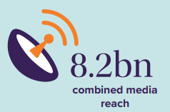
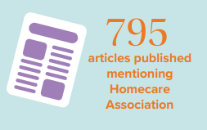
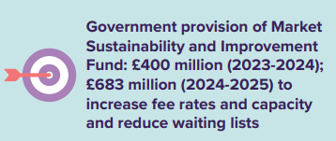
What we have achieved for the sector

