Slide 1

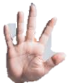
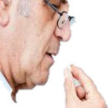
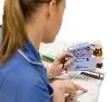
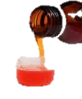

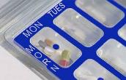

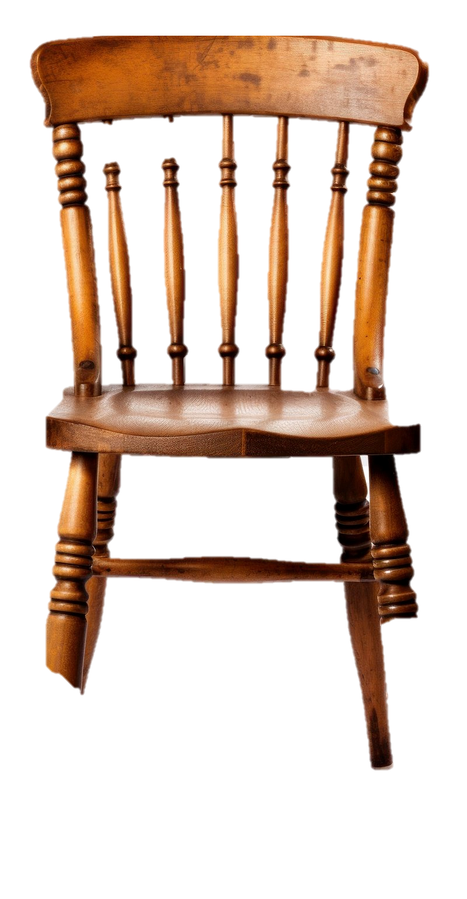
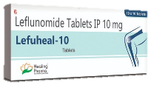


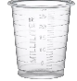
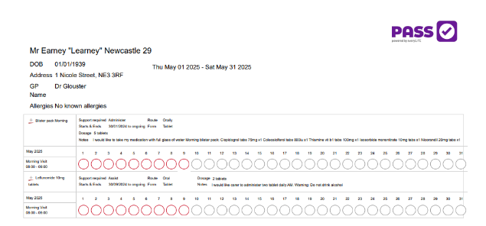
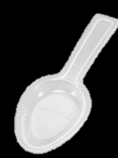
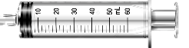
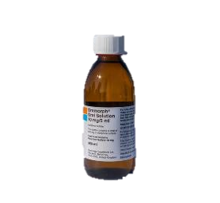




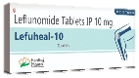
Prior to administration of medication,
there are some key checks that you should carry out
to enable the safe administration of medicines,
commonly knows as:
“The 6Rs” or “The 6 Rights”
The 6 Rights of Safe Medicines Administration
RIGHT PERSON
RIGHT MEDICINE
RIGHT DOSE
RIGHT TIME
RIGHT ROUTE
RIGHT to REFUSE
Right Dose
Right Time
Right to Refuse
Right Medicine
Right Route
Right Person
Always check dose on the pharmacy label and MAR/eMAR
Remember to check if you are administering out of right slot
Remember that your client has got right to refuse medication
Remember to check medicines against MAR/eMAR chart
Check that you are administering medication via correct route i.e., Oral
Ensuring the correct person you support gets the medication
Mr Earney “Learney
RIGHT RECORDING

Slide 2

RIGHT ADMINISTRATION GONE WRONG
Group
Discussion
WRONG PERSON
WRONG MEDICINE
WRONG DOSE
WRONG TIME
WRONG ROUTE
WRONG RIGHT to REFUSE
Let’s talk about errors and near misses
What would we advise?

Slide 3

Medication Errors
​
237 million medication errors are made
annually, with errors made at every stage
of the medication process.​
21% are made during prescribing​
16% are made during dispensing​
54% are made during administration​
​
?
?
?

Slide 4

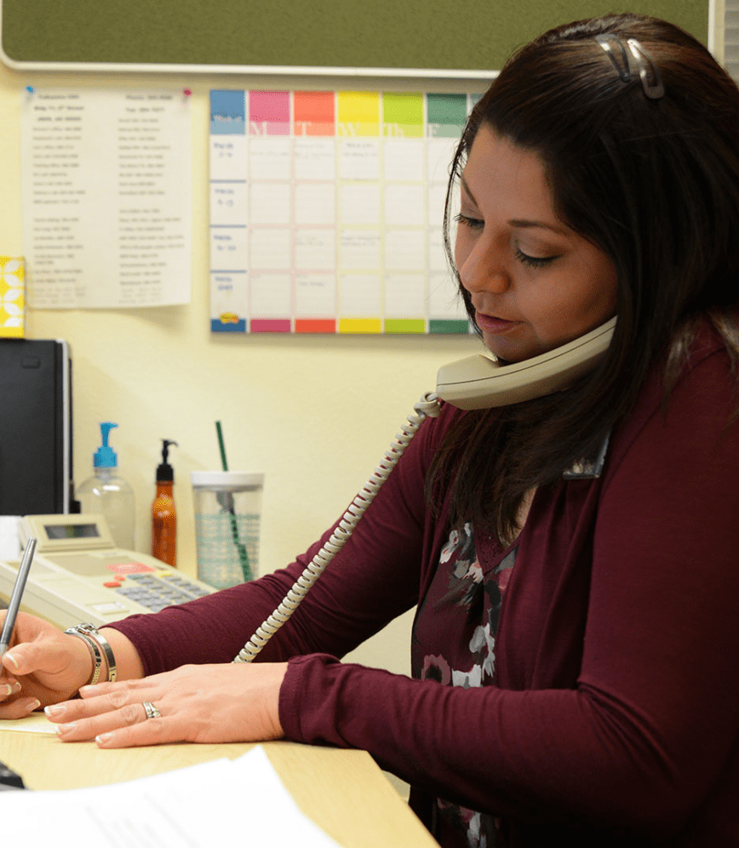

What should we advise?
Do not give the medication yet. There's a discrepancy between the MAR chart and the pharmacy label. Contact the pharmacy to confirm the correct dose. Document your findings in the care notes
We need to arrange a GP review to consider switching the medication form and possibly involve SALT, could you give the gp a call. Document both incidents in the care notes.
Observe the client closely for any signs of side effects. call 111 or the GP for advice on next steps. Please make sure everything is documented clearly in the care notes, and I’ll complete a medication error log.
Do not give the medication yet. Alcohol can interact dangerously with certain medicines. Check medication leaflets and contact the GP/pharmacy/111 for further advice.
Do not give any dose yet. We can't confirm if it was missed or not taken. Take a photo of the dosette box, document your findings, and I’ll investigate this immediately.
Please do not give medication. If the dosette box is tampered with, we can't ensure its safety. Take a photo, document your observation in the care notes, and I'll arrange for the meds box to be returned or replaced
Do not give medication from another slot. To avoid a double dose. Check MAR chart and care notes for prior administration. Call pharmacy to discuss possible missed dose. Document your findings.
Good evening, I am about to administer medication from dossette box, it appears to have been popped and Sellotaped over, should I still give this?
Hello, I am administering liquid medication. The pharmacy label states 5ml, but the Mar chart states 15ml. How many ml should I give?
Evening!, I have checked clients dossete box and the AM medication is still there. Mar chart has been signed and care notes state these were administered?
Good morning, I have accidently given my client two tablets when she was only supposed to take one, what should I do?
Hello, I am here to administer morning medication and the slot in the dosette box is empty, what should I do?
Good evening, I am with my client, they have drunk alcohol can I still administer the medication?
Hi, I am calling with a concern. My client has choked on tablet twice this week? What action should I take?

Slide 5
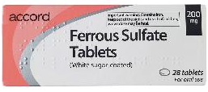

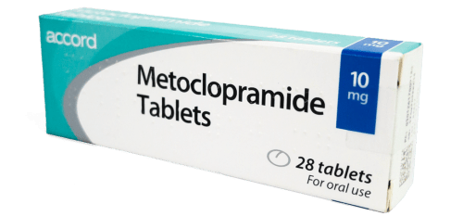
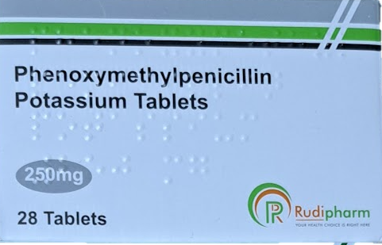
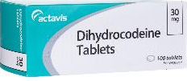
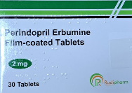
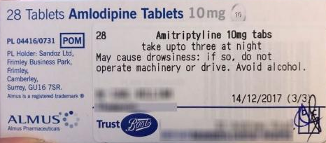
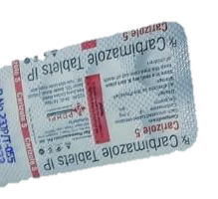

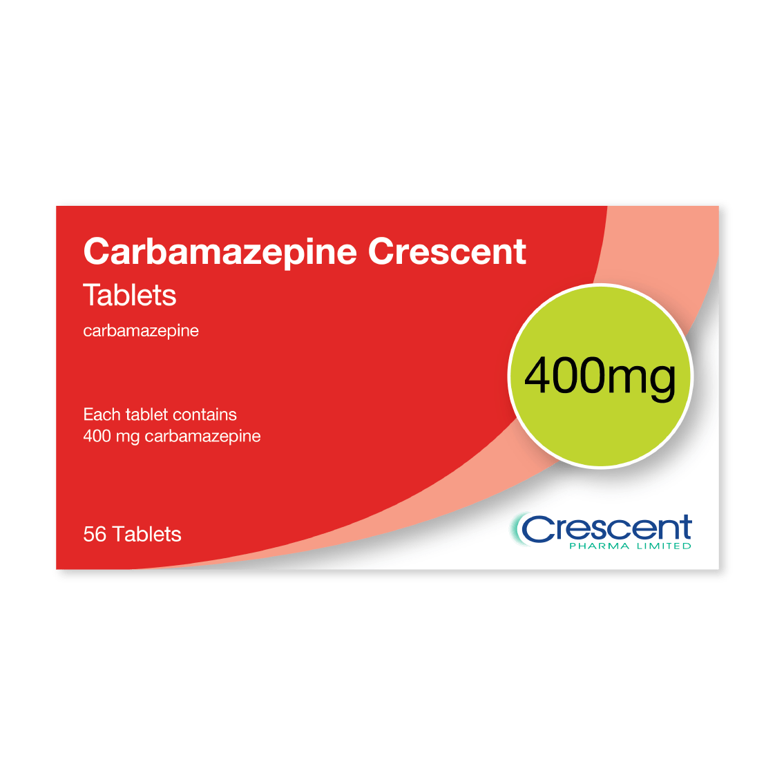
Right Medication?
LASA – Look – Alike, Sound - Alike
Amlodipine
Amitriptyline
Atenolol
Allopurinol
Carbamazepine
Carbimazole
Propranolol
Prednisolone
Rivaroxaban
Rosuvastatin

Slide 6

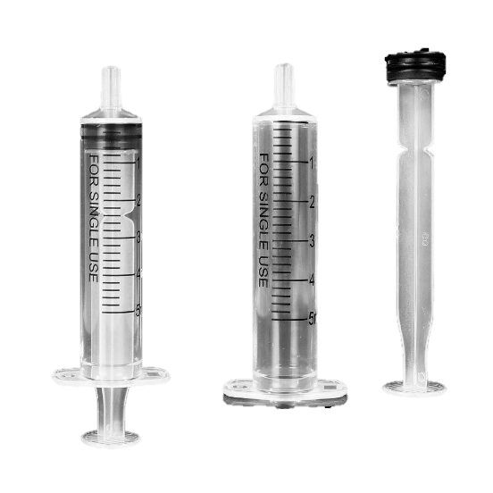
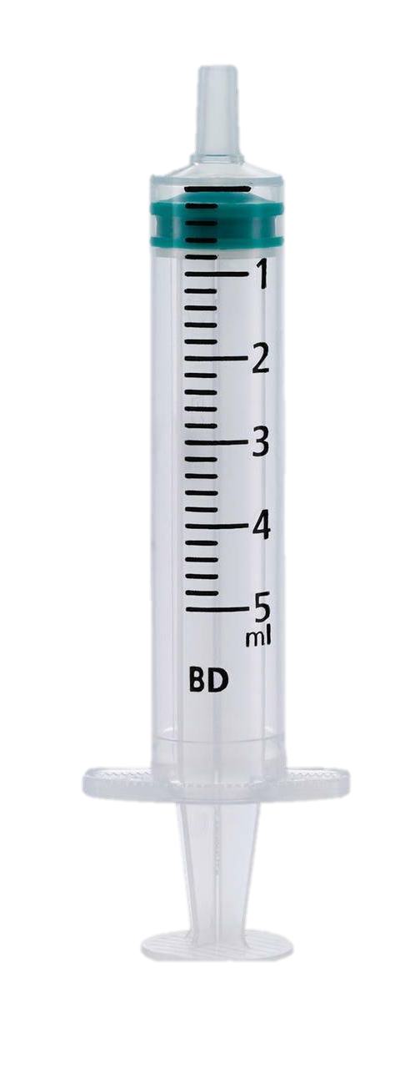
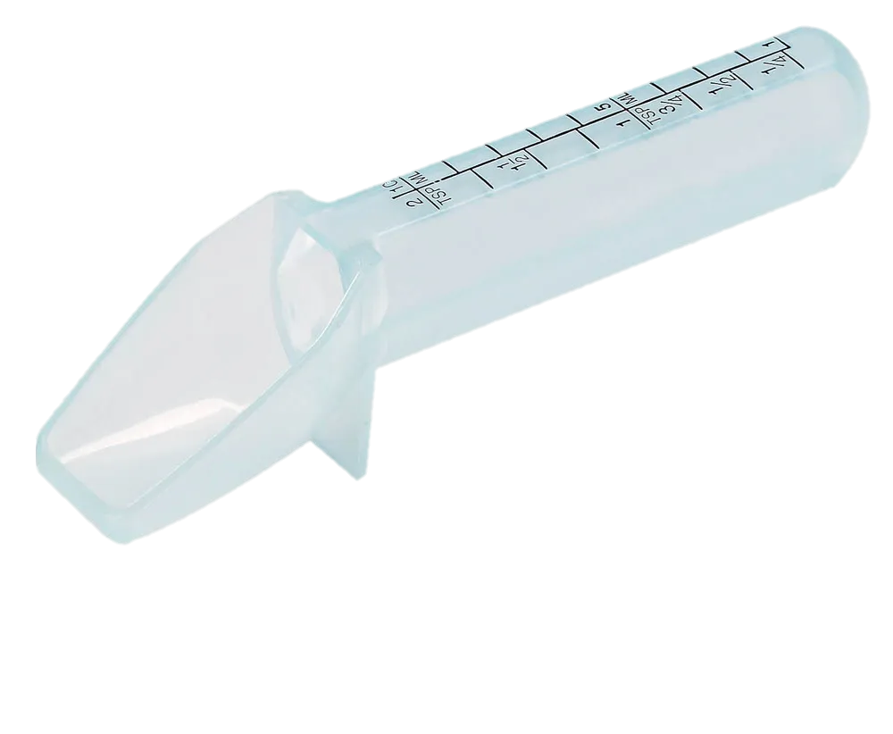
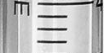
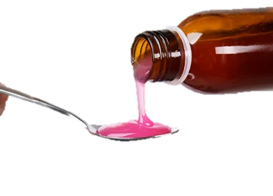
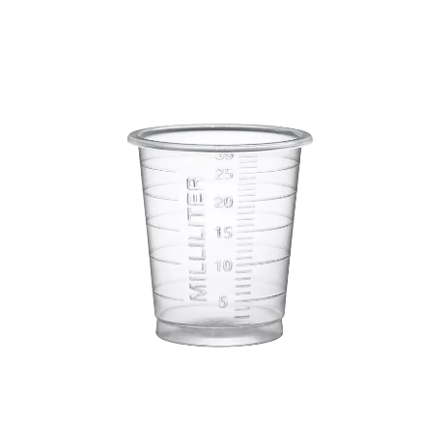
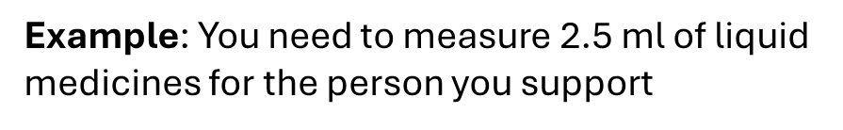
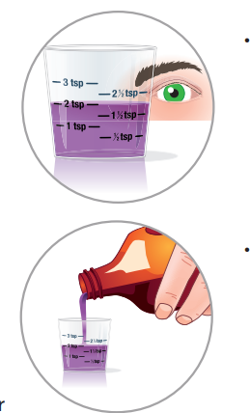
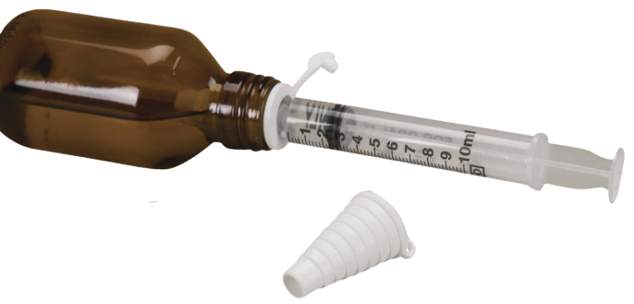
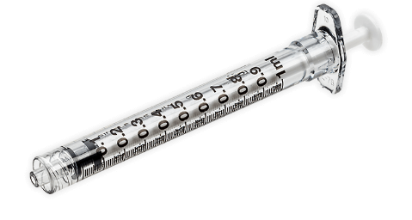

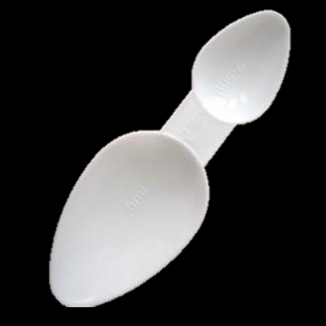
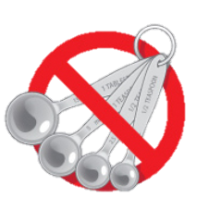
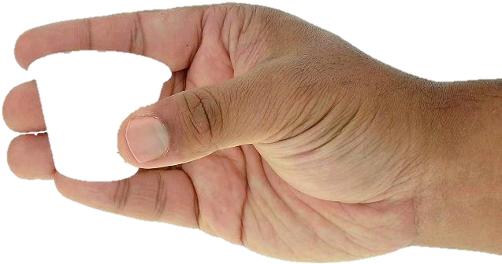
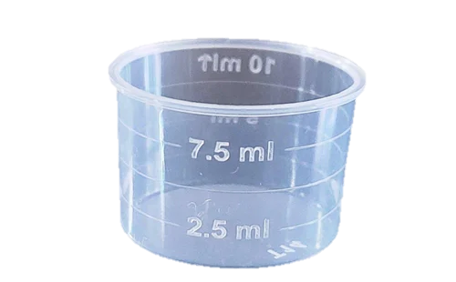
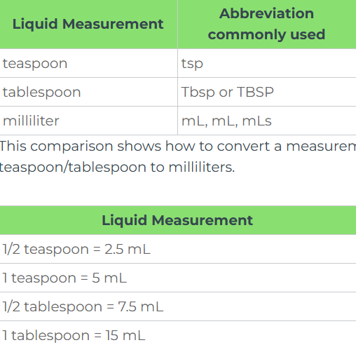
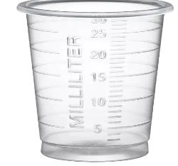

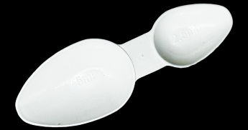
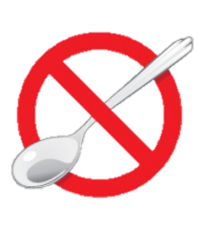
Right Dose?
How to measure liquid medication with different device
Always use a proper measuring device
How can we do it correctly?
A day:1 ml extra x 4 daily = 4 ml over recommended daily dose
A week: 4ml x 7 days = 28 ml
Over 28 days= 112 ml
Read abbreviations used in dosage directions carefully. Abbreviations for teaspoons and tablespoons are similar.
This comparison shows how to convert a measurement from teaspoon/tablespoon to milliliters..
Not quite, we have measured incorrect amount of liquid 2.8 ml instead of 3 ml.
This is 0.2 ml less the recommended dose.
Example: You need to measure 3 ml of liquid medicines for the person you support.
Do you think measuring
liquid medication is easy?
Is everything correct?
Example: You need to measure 10 ml of liquid medicines for the person you support
It turns out that it’s not so easy.
Is everything correct?
Not quite
Never use teaspoons, tablespoons or other household spoons to measure medicine. They are not uniformly sized.
Is everything correct?
Not quite, we have measured incorrect amount of liquid 11 ml instead of 10 ml.
This is 1 ml over the recommended dose.
If you are told to measure teaspoons (tsp), or tablespoons (Tbsp), always make sure you use
a measuring device that is marked clearly with your dose
Syringes
A day: 0.2 ml x 4 daily = 0.8 ml less than recommended daily dose
A week: 0.8 ml x 7 days = 5.6 ml
Over 28 days: 22.4 ml
Measuring cups
Syringes
Measuring cups
Dosing spoons
Dosing spoons

Slide 7
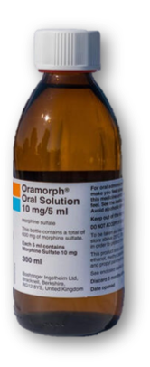
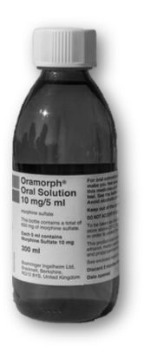
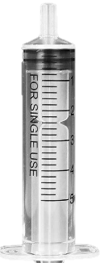
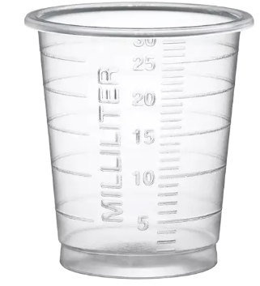



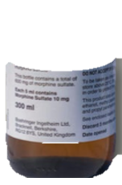

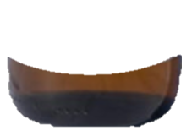
Right Dose?

Slide 8
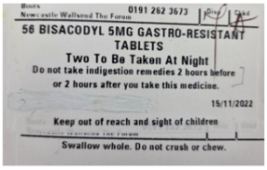
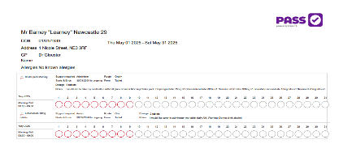

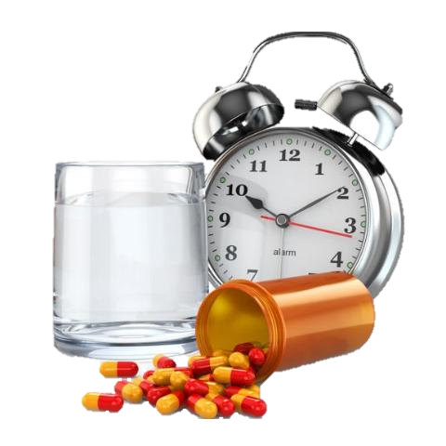
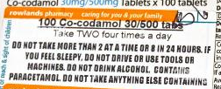


Right Time
Mr Earney “Learney
What does Right Time mean?
Giving medicines exactly as prescribed by GP or pharmacist
Including specific time of the day, special direction and correct spacing between dose
Time critical medication
Must be administered at a specific time to ensure effectiveness and prevent harm.
Delayed or missed does can lead to serious health consequence.
Key Points:
Always double check MAR chart and previous logs for last administration time before giving the next dose the
Be aware of time critical medication
Document the time of administration
Document and report any delays or refusals
If unsure, pause and clarify before administering

Slide 9
LEAVE 4 to 6 HOURS

Slide 10

















Routes of administration ( Right Route)
Oral
Taken Via the mouth and swallowed
i.e., tablets or syrup.
Inhalation
Taken by breathing into lungs i.e., to treat respiratory condition.
Topical
Medicine is applied directly to skin
i.e., creams or gels.
Rectal
Medicine is inserted high into rectum
i.e., suppository.
Vaginal
Medicine is applicated into vigia with a use of special applicator.
Buccal
Medicine is given between the gums and the inner lining of the mouth cheek.
Instillation
Medicine is administrated via eye, ear or nose
i.e., suspension or liquids.
Transdermal Patch
Medicine is administrated via adhesive patch that is placed on the skin.
Subcutaneous Injection
The medicine is injected directly under skin
i.e., insulin.
Intramuscular Injection
The medicine is injected directly into large muscles by doctors or trained nurse.
Intravenous (IV) Injection
Doctor or trained nurse administer medicines directly into the veins.
Sublingual
Medicine is place under the tongue i.e., nitroglycerin.

Slide 11










Instillation
Break out
Equal Groups
Micro Teach
Eye, Ear, and Nose Drops. It is good practice to write the date of opening onto the pharmacy label, as this should be used within 28 days, unless stated otherwise.
Dispose of any remaining product after this time to prevent contamination and ensure CQC compliance.

Slide 12





Asthma
Airways passage become inflamed, gets narrow due to excessive mucus, which makes breathing quite difficult.

Slide 13





Understanding Asthma - Inhalation

Slide 14







How to Apply a Transdermal Patch for a Client
Preparation:
  • Read Instructions • Hand Hygiene
Removing the Old Patch
  • Remove Gently • Dispose Properly
Choosing Preparing the New Site
  • Select a New Site • Clean the Skin
Dementia
Transdermal patch is a medicated adhesive patch placed on the skin to release slowly a specific does of medication into blood stream.
Hormone replacement HRT
Severe pain relief
4. Applying the New Patch
• Open Carefully • Avoid Touching Sticky Side • Apply Firmly
5.Finishing Up
•Dispose of Packaging • Hand Hygiene Again

Slide 15







Application of creams
Creams, Ointments and Emollients should be dated on opening, and disposed after 2 months, unless the manufacturer advised otherwise. This helps prevent contamination, ensures effectives and CQC compliance.

Slide 16










Slide 17







Types of medication ( Right Medication)
Activity 5
Why do you think it might be important to cover this in medication training going forward?
Activity 5
Break out
Pairs
Antibiotics
Anticoagulants
Treat or prevent bacterial infections.
Prevent blood clots.
1. Improves Safety
2. Supports Person-Centred Care
3. Builds Confidence
4. Aids Monitoring
5. Helps in Emergencies
Hormones
Laxatives
Rectify deficiencies of naturally occurring chemicals.
Alleviate constipation.
Antihistamines
Diuretics
Treat allergy symptoms.
Rid the body of excess fluid.

Slide 18





Types of medication
Antidepressants
Anti - inflammatory
Psychotropic medicines that treat depression.
Used to treat arthritis, muscle and joint
pain.
Antiemetics
Anticonvulsants
Treat nausea and vomiting.
Prevent and control epileptic seizures.
Analgesics
Antacids
Relieve indigestion or heartburn by neutralizing stomach acid.
Relieve pain from mild to severe pain.

Slide 19

Activity 5
Answers
H
M
A
L
Match the Medicine
G
C
F
D
E
K
B
I

Slide 20










Warfarin
Warfarin is a blood – thinning medicine ( anticoagulant). It helps prevent blood clots that can cause stroke, heart attack or lungs problems.
In UK warfarin tablets are colour – coded
Important considerations:
Monitor for sign of
Bruising,
Nosebleed
Prolonged bleeding.
If someone on warfarin falls, they may bleed inside without showing sign, you need to seek for medical advice.
Daily dose of warfarin is based on International normalised ration INR blood test and can be different every day.

Slide 21







A medication leaflet inside a medication box Typically contains important information about the medicine, including:
Purpose: What the medication is used for.
Usage Instructions: How to take the medication, including dosage and frequency.
Warnings: Situations when you should not use the medication.
Precautions: When to be careful while using the medication.
Side Effects: Possible adverse effects that may occur.
Ingredients: Active and inactive substances contained in the medication.
MHRA Products | Home

Slide 22



Medication Side Effect and Adverse Reaction
Side Effects
Are usually expected and non-serious consequences of taking certain medicines. They’re typically mild to moderate in intensity, not harmful or life-threatening, but can still be unpleasant or unwanted.
Adverse Reactions
Are unwanted or harmful responses that occur after taking a medication at the correct dose. They can range from mild discomfort to serious health problems, and often require medical attention, a dose change, or stopping the medicine altogether to prevent further harm.
Are they the same thing ?
No!

Slide 23











Side Effects – examples
Activity 6
Equal Groups
Activity 6
Relieve pain: reduce inflammation
and prevent blood clots
Treat asthma and allergies
Treats high cholesterol levels
❗Indigestion, Insomnia, Mood changes, weight gain
❗Nausea indigestion,
Cold-like symptoms, muscle pain
❗Indigestion or stomach discomfort. Can leave random bruises on your body
Prescribed for people with diabetes
Relieve pain and reduce inflammation
Treat bacterial infection
❗Diarrhoea, Stomach-ache, Loss of appetite
❗Can cause dizziness and
lightheadedness
❗Can cause gastric ulcers and bleeding
Antihistamines: treat allergies
Used to induce sleep
Relieve pain tenderness swelling
❗Can cause dry mouth, drowsiness
❗Can cause vivid dreams and nightmares
❗Can give you a tingling sensation and headache

Slide 24

Activity 6
C
F
Match the Side Effects
A
B
E

Slide 25







Adverse Reactions
Some medicines can cause adverse reactions in some people
Mouth & Face
Swelling of Mouth & Face
Chest & Lungs
Breathing Difficulties
Stomach & Abdomen
Nausea, Vomiting, or Diarrhoea
Head & Brain
Confusion, Hallucinations, Delusions Disorientation
Skin & Extremities
Sudden Rashes or Blotches

Slide 26






















Adverse Reactions, Allergies & Anaphylaxis
Sudden shortness of breath or difficulty breathing
Wheezing or noisy breathing
Tightness in the chest
Persistent coughing
Hoarse voice or trouble speaking
Swelling in the throat or tongue, making it hard to breathe or swallow
Rapid breathing or gasping for air
Blue or pale lips, face, or fingertips (a sign of low oxygen)
Abdominal pain or cramping
Nausea or vomiting
Diarrhea
Sudden loss of appetite
Feeling bloated or uncomfortable
Breathing
Breathing
●
●
●
Swelling
●
Swelling
Dizziness or light-headedness
Fainting or sudden collapse
Pale, cold, or clammy skin
Feeling weak or floppy
Confusion or disorientation
Skin reaction
Sudden flushing or warmth in the skin
Raised, red, itchy rash (hives)
Tingling or itching, especially around the mouth or hands
Swelling of the skin (angioedema)
Pale, cold, or clammy skin in severe cases
Skin reaction
Tongue or throat – can signal a serious reaction or anaphylaxis
Lips, face, or eyes – common in mild to moderate allergic reactions
Neck or upper airway – may cause difficulty breathing or swallowing
Hands or feet – less dangerous but still important to monitor
Sudden or spreading swelling – especially if paired with rash, dizziness, or breathing issues, needs urgent attention
●
●
Signs and Symptoms
●
Gastrointestinal
●
Gastrointestinal
Dizziness or fainting
Dizziness or fainting
●
●
Rapid or
Irregular
Heartbeat
Rapid or
Irregular
Heartbeat
●
●

Slide 27



Reactions, Allergies & Anaphylaxis
Allergy:
The immune system reaction to a harmless substance like pollen.
Example: Sneezing and itchy eye after being near a cat
Reaction:
A general body responds to something - not always allergy related.
Example: Skin turns red after using a new soap
Anaphylaxis: A severe, life-threatening allergic reaction that affects multiple body systems. It can occur seconds or minutes of exposure to an allergen or to a medication.
Example: Swelling, difficulty breathing, and drop in blood pressure after eating peanuts.
Immediate medical attention is critical. Call 999 or 112 immediately
Lay the person flat (unless they’re struggling to breathe — then let them sit).
Give adrenaline (e.g. EpiPen) if available and prescribed.
Stay with them and monitor condition.

Slide 28















The Administration Process
Wash hands
Put on gloves if required
Gain consent
Mar Chart- Check 6Rs
Select medicines
Check labels with MAR
Record exactly what was administered
Reorder medication
if necessary
Administer (Pack to Pot)
Wash hands again

Slide 29














Slide 30

Activity 7
Activity Equal Groups
Task 1 Abraham Tablet
Task 2 Cory Ander
Task 3 Melody Pill
Task 4 Earney Learny
Task 5 Colin Capsule

Slide 31



Right to refuse
Break out
Groups
Group 1
What should we do if a client refuses medication?
1.
2.
3.
4.
5.
6.
Fear of Side Effects
What should we do?
Common refusal reasons:
Group 2
Why might a person refuse their medication?
1.
2.
3.
4.
5.
6.
Assess the Situation
Mental Health Challenges
Ask why?
Encourage Without Pressure
Cultural or
Personal Beliefs
Check Capacity
Lack of Understanding
Seek Professional Advice
Document Everything
Physical Difficulties
Follow Policies
Distrust of
Healthcare Providers

Slide 32



Right to Refuse Done Wrong
Ignoring the Refusal
Not Reporting or Documenting the Refusal
Assuming the Person Lacks Capacity Without Assessment
Pressuring or Coercing the Individual
Not Exploring the Reason for Refusal
Hiding Medication in Food or Drink Without Consent (Covert Administration)
Covert medication is hidden (usually in food or drink) while Overt medication is given openly with the person’s knowledge and consent

Slide 33







Food & Drink Thickener
People with swallowing difficulties, knows as dysphasia may require modification to the texture of their food and liquids to help get the nutrition and hydration they need.
Key Points
  Thickens food and drinks for safe swallowing
  Ideal for people with dysphagia
  Easy to mix, tasteless, and quick
  Used in healthcare and home settings

Slide 34






























Disposal of unwanted, unused or out of date medication
DO NOT
Dispose of Mediation Improperly, it can:
pollute water,
harm wildlife
contaminate soil.
It’s bad for the environment – and may be illegal !
Gain consent from client to remove
Return to pharmacy
Inform Office
Record in care notes

Slide 35





Recording and reporting
According to Code of Conduct: As a Healthcare Support Worker or Adult Social Care Worker in England you must:
Communicate in an open, and effective way to promote the health, safety and wellbeing of people who use health and care services and their carers
Communicate in an open, and effective way to promote the health, safety and wellbeing of people who use health and care services and their carers
Remember
Call as many times as needed and
Record in as much detail as possible
Changes such as new medication/ completed course of medication/ missing medication ( e.g. family gave medication)
Refusal and action taken
Any concerns/ issues/ side effects
Call or visit from DN or GP whilst there including
new cream/ advice given
Error on MAR chart
Actions taken e.g. calling 111/ pharmacy
Medication orders
Returns of unwanted or out of date medicines
Time of administration
PRN

Slide 36
Activity 7
Independent
https://youtu.be/_Y9XDa7fS1E How not to Administer Medication
Notes:
YouTube Clips
https://youtu.be/_Y9XDa7fS1E How not to Administer Medication
https://youtu.be/BgWzdqjqlSk How to administer Medication

Slide 37
  Assessment of Competency in the Administration of Medication
1. Did the carer demonstrate hand hygiene prior to preparing the medication? | Yes/ No
2. Did the carer obtain client consent prior to the administration? | Yes/ No
3. Were the 6 rights of administration checked : Right Person, Right Medication, Right Time, Right route, Right dose, Right to refuse? | Yes/ No
4. Did the carer follow any special instructions on the MAR chart/ Pharmacy label? | Yes/ No
5. Has carer followed the MAR chart to ensure creams were applied in the correct way? | Yes/ No
Care worker did not perform hand hygiene or wear gloves before, during, or after administering medication. There was no use of hand sanitiser or mention of hygiene protocols throughout the visit.
Care worker did not obtain consent before administering medication. They did not ask if the client was ready or willing, and assumed medication was required without confirmation.
The care worker did not check any of the six rights. They failed to review the MAR chart or pharmacy labels, and the lead carer referred to the client by the wrong name twice. No verification was carried out before giving the medication.
The MAR chart and pharmacy labels were not checked for special instructions. The care worker relied solely on verbal advice from a colleague regarding what and how to administer. The carer also broke tablets without confirming if this was appropriate.
N/A. No creams were administered (or required) during this visit. (This was confirmed upon me checking) as the care worker had not reviewed the MAR chart for any required creams.

Slide 38
6.Was the carer aware of any relevant risk assessments for any of the prescribed medication? | Yes/ No
7. Did the carer prepare the medication appropriately using the non-touch method? | Yes/ No
8. Was liquid Medication prepared using oral syringe or pharmacy measured cup or spoon? | Yes/ No
9. Were soluble/ dispersible or effervescent tablets prepared correctly? | Yes/ No
10. Were eye/ear drops or nasal sprays or inhalers administered correctly according to the MAR chart and the pharmacy label? | Yes/ No
The care workers appeared unaware of specific risk assessments and did not consult the MAR chart or care plan to identify any risks. Labels were not checked.
The care workers did not use a non-touch technique when handling medications. A dirty plate with crumbs was used, and medication was physically handled during dispensing and when breaking tablets (at the client’s request).
The correct equipment was not used to administer the liquid medication. The care workers were unsure of the dosage and advised the client to drink directly from a dirty, unshaken bottle. Resulting in an inaccurate dose. One carer stated this method “saves washing up.”
No medication was prepared using dispersible methods. The care workers did not check the MAR chart or medication labels to see if this was required and broke tablets without confirming whether this was advisable.
The inhaler was found to be empty, no follow-up action was taken, leaving the client without one overnight. Lead care worker mentioned it would be sorted the next day, but the carer did not check for a replacement or escalate the issue.

Slide 39
11. Did the carer record all medication administration correctly? | Yes/ No
12. Was all PRN medication administered? If not, has the reason and correct code been recorded? | Yes/ No
13. Was the carer aware of any PRN protocols in place? | Yes/ No
14. Was a four-hour gap left between administration of medication (if applicable)? | Yes/ No
The Mar chart was completed before administration and not checks were made. Mar chart was not fully completed, and there was no documentation of the medication given or the omission of the inhaler.
PRN medication was not administered properly, and correct codes were not used or recorded. The client was not asked if she was in pain, and no observations were made for signs of distress during administration.
The care worker appeared unaware of any PRN protocols and did not check the MAR chart, pharmacy label, or care plan.
There was no evidence that the four-hour gap rule for time-sensitive medications was followed. The care workers did not check the MAR chart or pharmacy label, and no times were verified to ensure appropriate spacing between doses.

Slide 40
Overall comments about this assessment: Significant concerns were identified regarding medication safety, professionalism, and client care. Care workers failed to follow basic protocols, including not consulting the MAR chart, pharmacy labels, or care plan before administering medication. Unsafe practices included breaking tablets by hand, offering liquid medication from a dirty bottle, and failing to confirm ingestion. The client’s inhaler was missed entirely, with no documentation or follow-up. Professionalism was lacking. The lead carer was distracted, took a phone call during administration, and both carers took the client’s sweets without permission. They repeatedly used the wrong name and spoke over the client, causing visible distress. No consent was obtained for medication, and the client was told to drink cold tea instead of being offered fresh water. The environment was cluttered, hindering documentation. Records were incomplete and inaccurate. The MAR chart lacked entries for administered or omitted medications. Time-sensitive medications were not spaced appropriately, PRN protocols were ignored, and no pain assessments or correct coding were recorded. Conclusion: The medication process was unsafe and unprofessional. The carers demonstrated poor knowledge, communication, and disregard for person-centred care. Immediate suspension is recommended pending investigation, with full retraining in medication safety, professional conduct, risk assessment, and person-centred support. A formal apology to the client is advised.

Slide 41
https://youtu.be/BgWzdqjqlSk How to administer Medication
Notes:
YouTube Clips
https://youtu.be/_Y9XDa7fS1E How not to Administer Medication
https://youtu.be/BgWzdqjqlSk How to administer Medication

Slide 42




Medication Train the Trainer
Closing Pages
Initial Outcomes
To receive information and guidance in how to train your Care Workers to deliver medication services safely.
To gain knowledge on all aspects of providing medication services.
To discuss common errors. When things do go wrong and how to prevent and support.
To understand how competency can be tested.
Page 1

Slide 43



Our Learning Journey
Why we need to train the care workers in medication and how to train them efficiently.
Key legislations and the importance of the rules and regulations within that.
Classifications of medications.
How they're prescribed, supplied, transcribed and then administered.
Different levels of medication support.
Answers frequently asked questions.
Pharmacy labels and special directions.
6 Rights of medication administration.
Person, Medication, Dose, Time, Route and Right to refuse.
Medication errors and what we should do.
Side effects and adverse reactions.
Asthma, inhalers and warfarin.
Administration process.
Safe disposal of unwanted or out of date medication.
The importance of recording and reporting.
How to check the competencies of staff……..
Page 2
Page 3

Slide 44






Claire Douglas
(Presenter)
Link for a knowledge Check
https://becaring.typeform.com/TTTMeds
Edyta Debinska
(Editor)
Link for Feedback form
https://becaring.typeform.com/TTTmedsfeedback
Page 4
Page One
David French
(Moderator)

Slide 45


Thank you

